Slide 1
Indexing and Hashing

Slide 2
Indexing and Hashing
Basic Concepts
Ordered Indices
B⁺-Tree Index Files
B-Tree Index Files
Static Hashing
Dynamic Hashing
Comparison of Ordered Indexing and Hashing
Index Definition in SQL
Multiple-Key Access

Slide 3
Basic Concepts
Indexing mechanisms used to speed up access to desired data.
E.g., author catalog in library
Search Key - attribute to set of attributes used to look up records in a file.
An index file consists of records (called index entries) of the form
Index files are typically much smaller than the original file
Two basic kinds of indices:
Ordered indices: search keys are stored in sorted order
Hash indices: search keys are distributed uniformly across “buckets” using a “hash function”.
search-key
pointer

Slide 4
Index Evaluation Metrics
Access types supported efficiently.
e.g.,
records with a specified value in the attribute where deptno=‘D1’
or records with an attribute value falling in a specified range of values. where salary >=40000 and salary<=299999
Access time- time to find a particular data item, or set of items
Insertion time- time to find the correct place to insert the new data, to update the index structure
Deletion time - time to takes to find the item to be deleted , to update the index structure.
Space overhead-additional space occupied by an index structure
An attribute or set of attributes used to look up records in a file is called a search key and it is not necessarily same as primary key/candidate key
Notes:
Each technique must be evaluated on the basis of these factors:
• Access types: The types of access that are supported efficiently. Access types
can include finding records with a specified attribute value and finding
records whose attribute values fall in a specified range.
• Access time: The time it takes to find a particular data item, or set of items,
using the technique in question.
• Insertion time: The time it takes to insert a new data item. This value includes
the time it takes to find the correct place to insert the new data item, as well
as the time it takes to update the index structure.
• Deletion time: The time it takes to delete a data item. This value includes
the time it takes to find the item to be deleted, as well as the time it takes to
update the index structure.
• Space overhead: The additional space occupied by an index structure. Provided
that the amount of additional space is moderate, it is usually worthwhile
to sacrifice the space to achieve improved performance.
An attribute or set of attributes used to look up records in a file is called a
search key.

Slide 5
Ordered Indices
In an ordered index, index entries in the index file are stored sorted on the search key value. E.g., author catalog in library. slide
Primary index: in a sequentially ordered file, the index whose search key specifies the sequential order of the file. slide
Also called clustering index
The search key of a primary index is usually but not necessarily the primary key.
There are two types under this
Dense index & Dense Clustering Index
Sparse Index
Secondary index: an index whose search key specifies an order different from the sequential order of the file. Also called non-clustering index. Discussed latter in slide
Index-sequential file: ordered sequential file with a primary index.

Slide 6
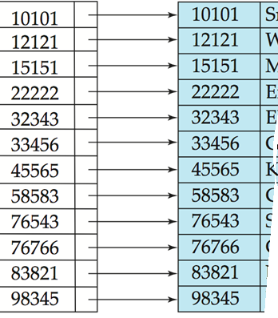
Ordered Indices
In an ordered index, index entries in the index file are stored sorted on the search key value.
ID
ID
Actual file
Index file ordered by search key –say ID
This is an Ordered Index file

Slide 7
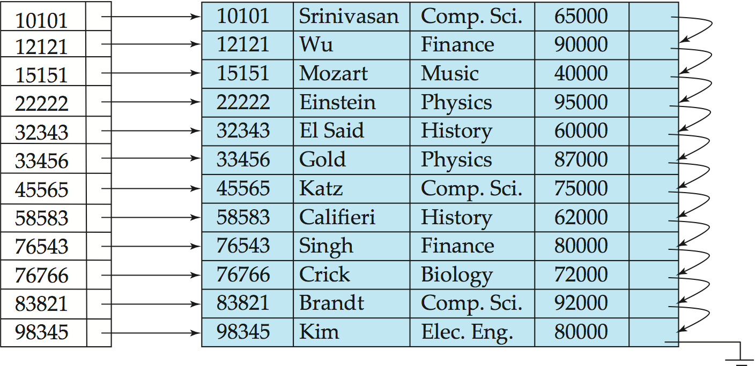
Ordered Indices (Contd..)
Primary index: in a sequentially ordered file, the index whose search key specifies the sequential order of the file.
Also called clustering index
The search key of a primary index is usually but not necessarily the primary key.
Index is created on ID attribute of Instructors which is in the sorted order
ID
Actual records are also in the order of ID
These type files known as Index-Sequential files
In fact this is dense index also- see
Notes:
Note that- Index is created on ID attribute of Instructors which is in the sorted order and physically actual records are also in the order of ID
The search key of a primary index is usually but not necessarily the primary key. Means there can be multiple records with same search key value-means search key value is not unique

Slide 8
Dense Index Files
Dense index — Index record appears for every kind of search-key value (for every ID value) in the file. Search Key value may be Unique/Duplicate
E.g. index on ID(unique) attribute of instructor relation
Notes:
Dense and Sparse categorized based
on one index entry per search key for group of records with same search key OR
one index entry per search key for group of any group of records (in sorted order of search key)
In a dense index, an index entry appears for every search-key value in the file.
In a dense clustering index, the index record contains the search-key value and a pointer to the first data record with that search-key
value. The rest of the records with the same search-key value would be stored sequentially after the first record

Slide 9
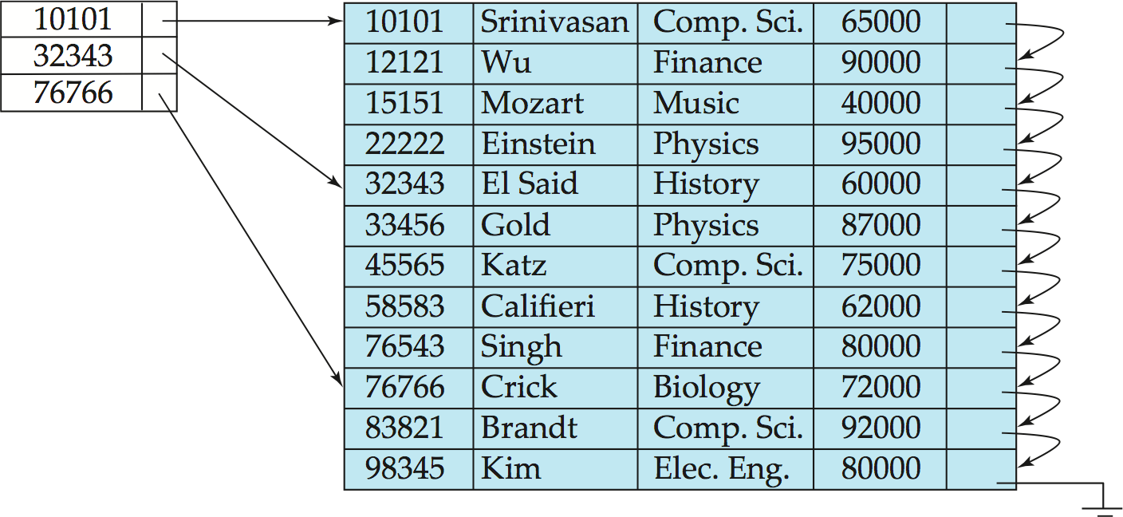
Sparse Index Files
Sparse Index: contains index records for only some search-key values.
10101 search key for set of records ranging search keys 10101 to 32342 and 32343 search key for set of records ranging search keys 32343 to 76765 and so on.
Applicable when records are sequentially ordered on search-key
To locate a record with search-key value K we:
Find index record with largest search-key value < K
Search file sequentially starting at the record to which the index record points
Assume we want search Instructor record with ID K=45565. Search the index file to find largest search key value < K.
i.e. 10101< 32343 < 45565
largest search key value < 45565 is 32343 , follow the pointer to reach record (32343,El Said,History,60000) in the file.
Search sequentially from this point to reach out required account (45565,Katz,Comp.Sc.75000)
Notes:
Primary(Clustering) –Actual Records in file are in the order oy search-key( i.e ID) .
Sparse- Index do not contains all search key values. ( not all ID values appear in Index file , only 3 types of ID values 10101,32343 & 76767 appear in index file)
Assume we want search Instructor record with ID K=45565. Search the index file to find largest search key value < K.
i.e. 10101<32343<45565 , largest
largest search key value < 45565 is 32343 , follow the pointer to reach record <32343,El Said,History,60000> in the file.
Search sequentially from this point to reach out required account <45565,Katz,Comp.Sc.75000>

Slide 10
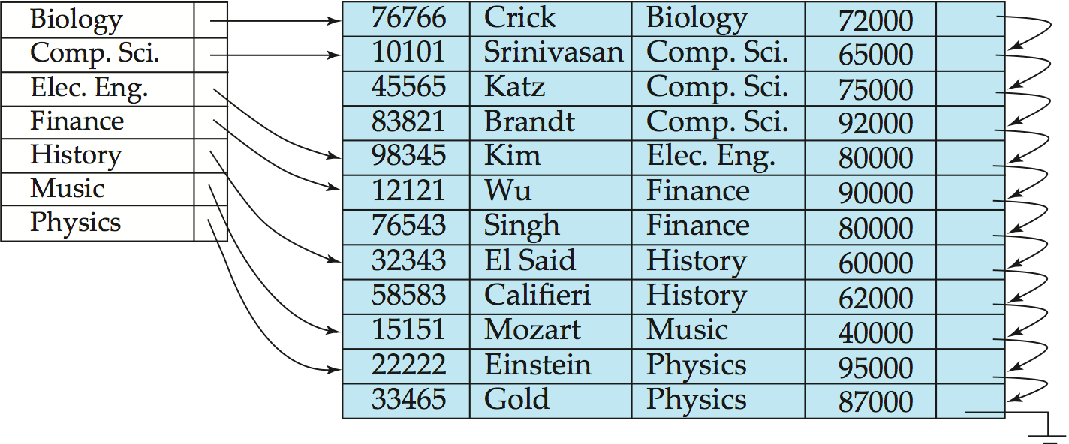
Dense Cluster Index Files
In a dense clustering index, the index record contains the search-key value and a pointer to the first data record with that search-key value. The rest of the records with the same search-key value would be stored sequentially after the first record.(one index entry for a cluster(group) of records with same search key value-one pointer to cluster)
Dense Cluster index on dept_name, with instructor file sorted on dept_name
In a dense non-clustering index, the index must store a list of pointers to all records with the same search-key value.
Notes:
Dense- Every type of search key value(Dept_Name values) has an entry in index file.
Cluster (Primary) Index- Records are stored sequentially in the order of Dept_Name. Hence the file is both Dense & Cluster index.
In a dense clustering index, the index record contains the
search-key value and a pointer to the first data record with that search-key
value. The rest of the records with the same search-key value would be stored
sequentially after the first record, since, because the index is a clustering one,
records are sorted on the same search key.
Dense index implementations may store a list of pointers to all records with
the same search-key value; doing so is not essential for primary indices.

Slide 11
Dense Non-Cluster Index Files
In a dense non-clustering index, the index must store a list of pointers to all records with the same search-key value. (Multiple records with same key value exist-search key not unique but one index entry per kind of search key value but pointer to all records with same key)
In the above example , we can see an index entry Comp.Sc is having list of 3 pointers pointing to Instructors with IDs 10101,45565,83821. Similarly Index entry Finance is having list of 2 pointers pointing to Instructor records with IDs-12121,76543, Similarly we can see list of pointers for index entry History & Physics also.
Notes:
Dense- Every type of search key value(Dept_Name values) has an entry in index file.
In a dense nonclustering index, the index must store a list of pointers to all records with the same search-key value.
In the above example , we can see an index entry Comp.Sc is having list of 3 pointers pointing to Instructors with IDs 10101,45565,83821. Similarly Index entry Finance is having list of 2 pointers pointing to Instructor records with IDs-12121,76543, Similarly we can see list f pointers for index entry History & Physics also.

Slide 12
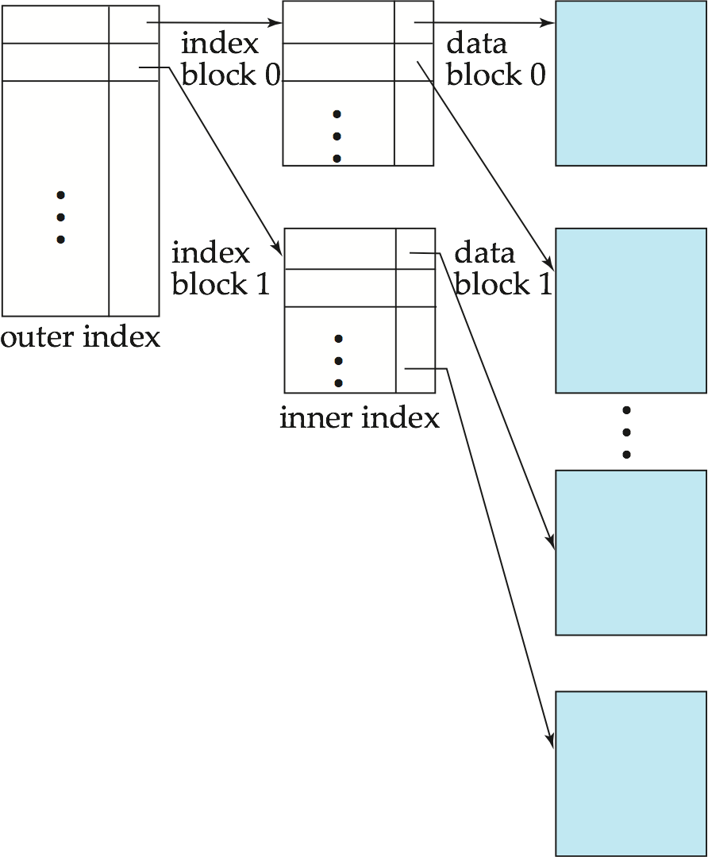
Sparse Index Files (Cont.)
Compared to dense indices:
Less space and less maintenance overhead for insertions and deletions.
Generally slower than dense index for locating records.
Good tradeoff: There is a trade-off that the system designer must make between access time and space overhead depending on application under consideration.
A good compromise is to have a sparse index with one index entry per block.
Bringing one Block at a time from Hard disk
(involves 1 seek & 1 Rotational Delay)
to memory and searching required key in
the block (Searching in memory less time)

Slide 13
Index-Insert & Delete Operations
Regardless of what form of index is used, every index must be updated whenever
A record is either inserted into or deleted from the file.
A record in the file is updated, any index whose search-key attribute is affected by the update must also be updated
Such a record update can be modeled as
A deletion of the old record, followed by an insertion of the new value of the record, which results in an index deletion followed by an index insertion.
As a result we only need to consider insertion and deletion on an index
We first describe algorithms for updating single-level indices.

Slide 14
Index Update: Insertion
Insertion. First, the system performs a lookup using the search-key value that appears in the record to be inserted. The actions the system takes next depend on whether the index is dense or sparse:
◦ Dense indices:
1. If the search-key value does not appear in the index, the system inserts an index entry with the search-key value in the index at the appropriate position.
2. Otherwise the following actions are taken:
a. Dense Non-Clustering- If the index entry stores pointers to all records with the same search key value, the system adds a pointer to the new record in the index entry.
b. Dense Clustering- Otherwise, the index entry stores a pointer to only the first record with the search-key value. The system then places the record being inserted after the other records with the same search-key values.
◦ Sparse indices: We assume that the index stores an entry for each block. If the system creates a new block, it inserts the first search-key value (in search-key order) appearing in the new block into the index. On the other hand, if the new record has the least search-key value in its block, the system updates the index entry pointing to the block; if not, the system makes no change to the index.
Notes:
Discuss process of updating index (in case of Dense /Sparse indices) when Insertion operation done on a file.

Slide 15
1. If the search-key value does not appear in the index…
If inserting <77777,XYZ,ABC,79000> , as there is no entry corresponding to 77777 then insert the record in file and create an index entry corresponding to 77777 after 76766 and pointer pointing to <77777,XYZ,ABC,79000>
Notes:
If inserting <77777,XYZ,ABC,79000> , as there is no entry corresponding to 77777 then insert the record in file and create an index entry corresponding to 77777 and pointer pointing to <77777,XYZ,ABC,79000>

Slide 16
2a. If the index entry stores pointers to all records (Dense non-clustering)
2a. Assume a small change in the figure , say Comp.Sc index entry has three pointers to each three records <10101,..,Comp.Sci..> ,<45565,..Comp.Sc..>, <83821,…,CompSc…> , assume we want to Insert <85555,…,Comp.Sc..> , insert the record in file at proper place( between Brandt and Kim) and an new pointer entry in index file corresponding to Comp.Sc pointing to <85555,…,Comp.Sc..>
Notes:
2a. Assume a small change in the figure , say Comp.Sc index entry has three pointers to each three records <10101,..,Comp.Sci..> ,<45565,..Comp.Sc..>,<83821,…,CompSc…> , assume we want to Insert <85555,…,Comp.Sc..> , insert the record in file at proper place and an new pointer entry in index file corresponding to Comp.Sc pointing to <85555,…,Comp.Sc..>
2b. Assume we want to insert <88888,….Comp.Sci..> then insert it in proper place in file (to maintain sort order of Dept_name) i.e. after <83821,…,Comp Sci..>

Slide 17
2b. If the index entry stores a pointer to only the first record with same search-key value… (Dense-Clustering Index)
2b. Assume we want to insert <88888,….Comp.Sci..> then insert it in proper place in file (to maintain sort order of Dept_name) i.e. after <83821,…,Comp Sci..>
Notes:
2a. Assume a small change in the figure , say Comp.Sc index entry has three pointers to each three records <10101,..,Comp.Sci..> ,<45565,..Comp.Sc..>,<83821,…,CompSc…> , assume we want to Insert <85555,…,Comp.Sc..> , insert the record in file at proper place and an new pointer entry in index file corresponding to Comp.Sc pointing to <85555,…,Comp.Sc..>
2b. Assume we want to insert <88888,….Comp.Sci..> then insert it in proper place in file (to maintain sort order of Dept_name) i.e. after <83821,…,Comp Sci..>

Slide 18
Insert : in case of Sparse indices
EMP Relation
100 | Ravi | 2000 | Disk Block-1
101 | Raj | 3000
102 | Vikram | 5000
103 | Santhosh | 4000 | Disk Block-2
104 | Ajay | 7000
105 | Anoop | 8000
107 | Sanoop | 9000 | Disk Block-3
109 | Rakesh | 7000
Sparse Index
100
103
107
Assume that each disk block has space to accommodate 3 records.
When record inserted, If the system creates a new block-
Assume two records <110,…,…> & <112,…,…> are inserted.
<110,….> is added after <109,…,…> and new disk block-4 created and <112,..,…> is added into it.
And new entery-112 is create in spare index with pointer pointing to 1st record <112,…,…> in disk block 4
If the new inserted record has the least search-key value in its block-
Assume that a record <106,…,…> is added to the EMP relation, it must be inserted before <107,..,..> and 3rd index entry 107 is changed to 106 so that the pointer points <106,…,…>
Otherwise-
Assume that a record <110,…,…> is added to the EMP relation, it is inserted after <109,..,..> and no change is made to sparse index.
Notes:
Assume that each disk block has space to accommodate 3 records.
Sparse indices: We assume that the index stores an entry for each block. If the system creates a new block, it inserts the first search-key value (in search-key order) appearing in the new block into the index. On the other hand, if the new record has the least search-key value in its block, the system updates the index entry pointing to the block; if not, the system makes no change to the index.

Slide 19
Secondary Indices
Frequently, one wants to find all the records whose values in a certain field (which is not the search-key of the primary index) satisfy some condition.
Assume that, in the instructor relation, records are stored sequentially by ID, also assume that there may be an index created on search_key ID. i.e. Primary index on ID.
Example 1:We may want to find all instructors in a particular department.
Example 2: We want to find all instructors with a specified salary or with salary in a specified range of values.
In the above two examples, we may need two different index files on Dept_name , Salary respectively. In both index files, Dept_name values are sorted order(1st index) and Salary values in sorted order in (2nd Index file). However actual Instructor record are in different order(by ID) than Dept_name or Salary.
We can have two separate secondary index for each search-key value (dept_name as well as Salary)

Slide 20
Secondary Indices Example
Record are in the order of ID in the file , but not by salary
Index entries are in order of salary
Secondary index on salary field of instructor
Index record points to a bucket that contains pointers to all the actual records with that particular search-key value.
Secondary indices have to be dense
Notes:
20

Slide 21
Primary and Secondary Indices
Indices offer substantial benefits when searching for records.
BUT: Updating indices imposes overhead on database modification --when a file is modified, every index on the file must be updated,
Sequential scan using primary index is efficient, but a sequential scan using a secondary index is expensive.
Because secondary-key order and physical-key order differ, if we attempt to scan the file sequentially in secondary-key order, the reading of each record is likely to require the reading of a new block from disk, which is very slow. Each record access may fetch a new block from disk
Block fetch requires about 5 to 10 milliseconds, versus about 100 nanoseconds for memory access
Notes:
21

Slide 22
Multilevel Index
If primary index does not fit in memory, access becomes expensive.
Solution: treat primary index kept on disk as a sequential file and construct a sparse index on it.
outer index – a sparse index of primary index
inner index – the primary index file
If even outer index is too large to fit in main memory, yet another level of index can be created, and so on.
Indices at all levels must be updated on insertion or deletion from the file.
Notes:
Suppose we build a dense index on a relation with 1,000,000 tuples. Index entries
are smaller than data records, so let us assume that 100 index entries fit on a
4 kilobyte block. Thus, our index occupies 10,000 blocks. If the relation instead
had 100,000,000 tuples, the index would instead occupy 1,000,000 blocks, or 4
gigabytes of space. Such large indices are stored as sequential files on disk.
If an index is small enough to be kept entirely in main memory, the search
time to find an entry is low. However, if the index is so large that not all of it
can be kept in memory, index blocks must be fetched from disk when required.
(Even if an index is smaller than the main memory of a computer, main memory
is also required for a number of other tasks, so it may not be possible to keep
the entire index in memory.) The search for an entry in the index then requires
several disk-block reads.
To deal with this problem, we treat the index just as we would treat any other
sequential file, and construct a sparse outer index on the original index, which we
now call the inner index, as shown in next slide

Slide 23
Multilevel Index (Cont.)
Notes:
To deal with this problem of large primary index, we treat the index just as we would treat any other
sequential file, and construct a sparse outer index on the original index, which we
now call the inner index, as shown in next slide
How to search records in the multi-Level index ?
Note that the index entries are always in sorted order, allowing the outer index to be sparse. To locate a record,
we first use binary search on the outer index to find the record for the largest
search-key value less than or equal to the one that we desire. The pointer points
to a block of the inner index. We scan this block until we find the record that
has the largest search-key value less than or equal to the one that we desire. The
pointer in this record points to the block of the file that contains the record for which we are looking.

Slide 24
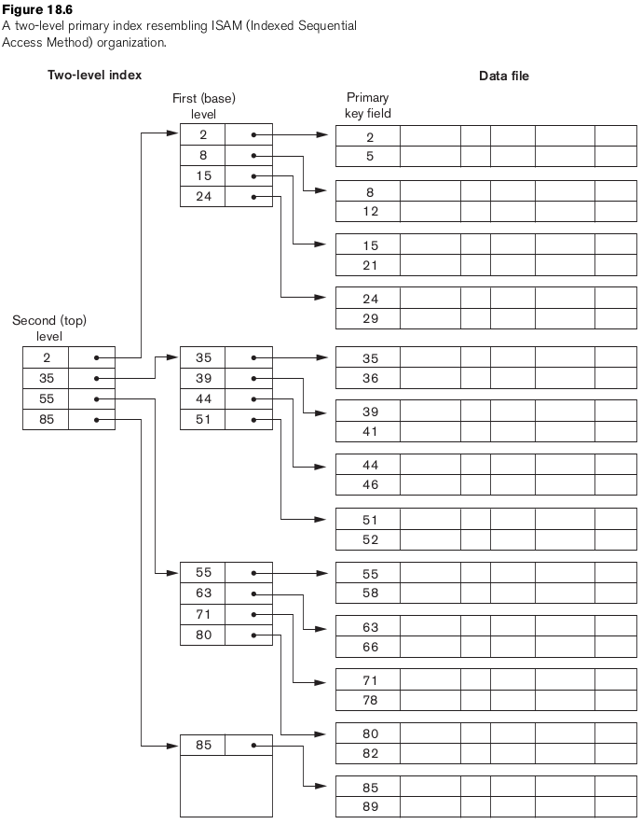
Example: Multilevel Index

Slide 25
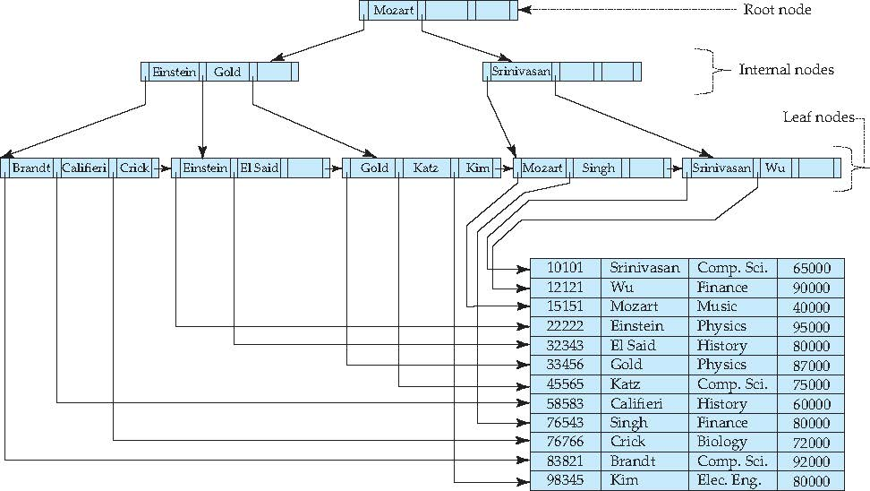
Example of B⁺-Tree Index & Data File
B⁺ Tree index, Search-Key value is based on Name field of Instructor.
Index keeps search key(Name) values in alphabetical order
n- maximum number of pointers to next node allowed=4
Notes:
n- maximum number of children(in other words Pointers) allowed.
B+ Tree index created based on Name column, i.e. Search-Key value is based on Name field.
In non-leaf nodes, for example, Pointer Left to Einstein move search towards records having name value lesser than Einstein &
Pointer Right to Einstein move search towards records having name value Grater or Equal to Einstein

Slide 26
B⁺-Tree Index Files
B⁺-tree indices are an alternative to indexed-sequential files.
Disadvantage of indexed-sequential files
performance degrades as file grows, since many overflow blocks get created.
Periodic reorganization of entire file is required.
Advantage of B⁺-tree index files:
automatically reorganizes itself with small, local, changes, in the case of insertions and deletions.
Reorganization of entire file is not required to maintain performance.
A B⁺-tree index takes the form of a balanced tree.
(Minor) disadvantage of B⁺-trees:
Extra insertion and deletion overhead, space overhead.
Advantages of B⁺-trees outweigh disadvantages
B⁺-trees are used extensively
Notes:
Discuss advantages and disadvantages of B⁺ trees in comparison with indexed-sequential files.

Slide 27
Index Definition in SQL
Create an index
create index <index-name> on <relation-name> (<attribute-list>)
E.g.: create index b-index on branch(branch_name)
Not really required if SQL unique integrity constraint is supported
To drop an index
drop index <index-name>
Most database systems allow specification of type of index, and clustering.

Slide 28
Multiple-Key Access
Use multiple indices for certain types of queries.
Example:
select ID
from instructor
where dept_name = “Finance” and salary = 80000
Possible strategies for processing query using indices on single attributes:
1. Use index on dept_name to find instructors with department name Finance; test salary = 80000
2. Use index on salary to find instructors with a salary of $80000; test dept_name = “Finance”.
Use dept_name index to find pointers to all records pertaining to the “Finance” department. Similarly use index on salary.
Take intersection of both sets of pointers obtained.

Slide 29
Indices on Multiple Attributes
Composite search keys are search keys containing more than one attribute
E.g. (dept_name, salary)
Suppose we have an index on combined search-key
(dept_name, salary).
With the where clause where dept_name = “Finance” and salary = 80000 the index on (dept_name, salary) can be used to fetch only records that satisfy both conditions.
Using separate indices in less efficient — we may fetch many records (or pointers) that satisfy only one of the conditions.
Can also efficiently handle where dept_name = “Finance” and salary < 80000
But cannot efficiently handle where dept_name < “Finance” and balance = 80000
May fetch many records that satisfy the first but not the second condition

Slide 30
Static Hashing
A bucket is a unit of storage containing one or more records (a bucket is typically a disk block).
In a hash file organization we obtain the bucket of a record directly from its search-key value using a hash function.
Hash function h is a function from the set of all search-key values K to the set of all bucket addresses B.
Hash function is used to locate records for access, insertion as well as deletion.
Records with different search-key values may be mapped to the same bucket; thus entire bucket has to be searched sequentially to locate a record.

Slide 31
Example of Hash File Organization
Hash file organization of instructor file, using dept_name as key (See figure in next slide.)
There are 10 buckets,
The binary representation of the ith character is assumed to be the integer i.
The hash function returns the (sum of the binary representations of the characters) modulo 10
E.g. h(Music) = 1 h(History) = 2 h(Physics) = 3 h(Elec. Eng.) = 3
Notes:
M=77 u=117 s=115 i=105 c=99 77+117+115+105+99

Slide 32
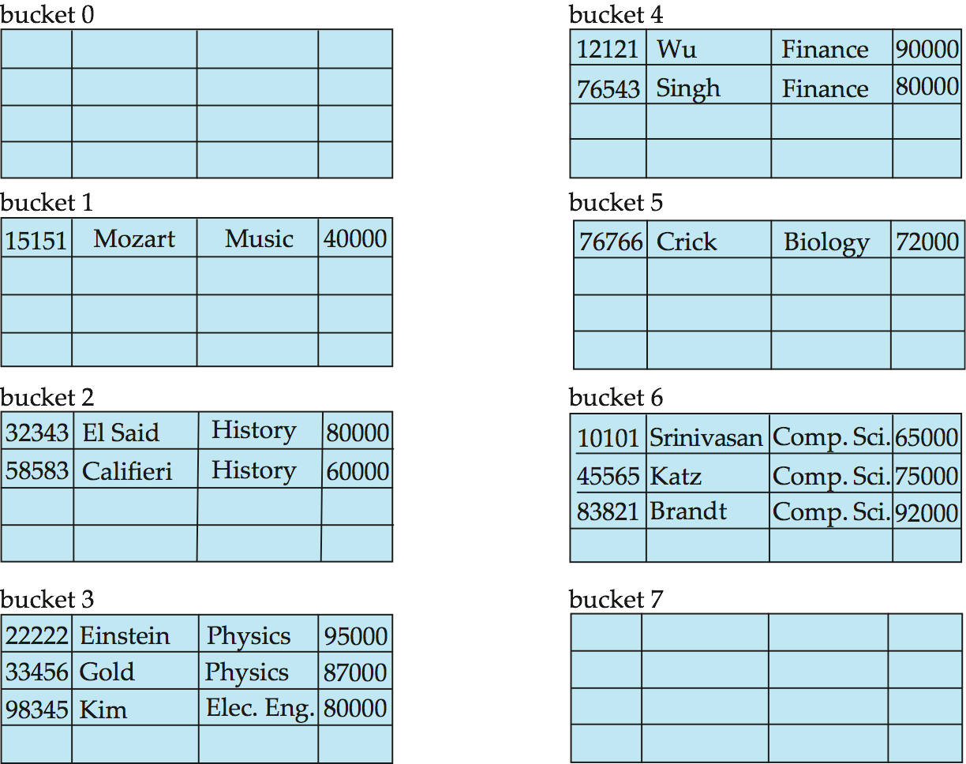
Example of Hash File Organization
Hash file organization of instructor file, using dept_name as key (see previous slide for details).

Slide 33
Hash Functions
Worst hash function maps all search-key values to the same bucket; this makes access time proportional to the number of search-key values in the file.
An ideal hash function is uniform, i.e., each bucket is assigned the same number of search-key values from the set of all possible values.
Ideal hash function is random, so each bucket will have the same number of records assigned to it irrespective of the actual distribution of search-key values in the file.
Typical hash functions perform computation on the internal binary representation of the search-key (Extendable hashing).
For example, for a string search-key, the binary representations of all the characters in the string could be added and the sum modulo the number of buckets could be returned. .

Slide 34
Handling of Bucket Overflows
Bucket overflow can occur because of
Insufficient buckets
Skew in distribution of records. This can occur due to two reasons:
multiple records have same search-key value
chosen hash function produces non-uniform distribution of key values
Although the probability of bucket overflow can be reduced, it cannot be eliminated; it is handled by using overflow buckets.

Slide 35
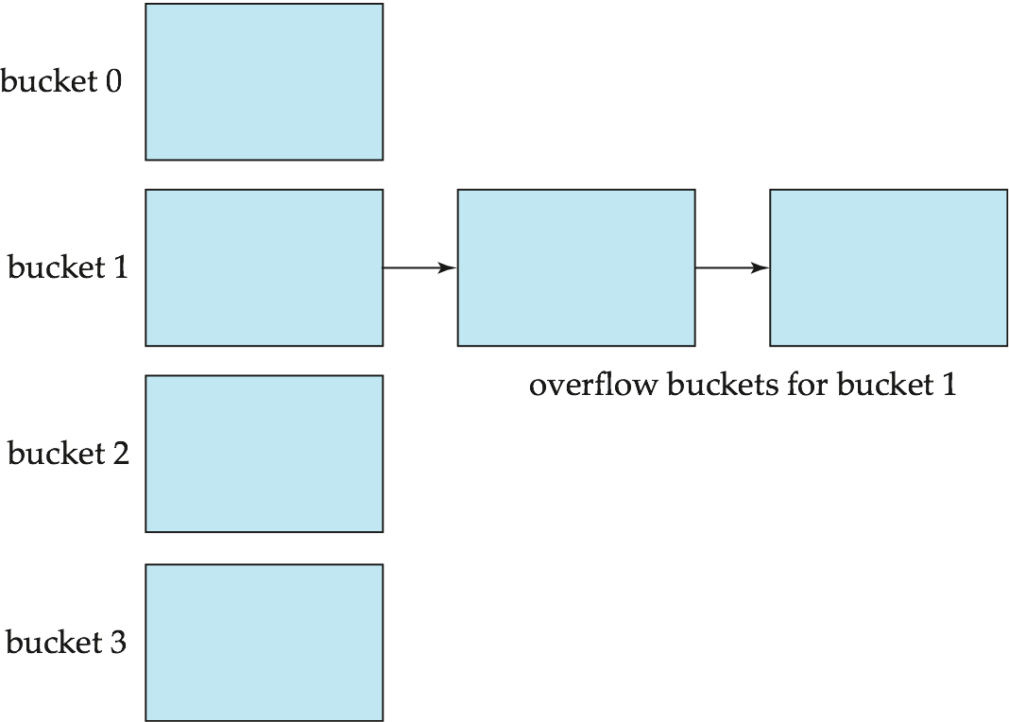
Handling of Bucket Overflows (Cont.)
Overflow chaining – the overflow buckets of a given bucket are chained together in a linked list.
Above scheme is called closed hashing.
An alternative, called open hashing, which does not use overflow buckets, is not suitable for database applications.

Slide 36
Hash Indices
Hashing can be used not only for file organization, but also for index-structure creation.
A hash index organizes the search keys, with their associated record pointers, into a hash file structure.
Strictly speaking, hash indices are always secondary indices
if the file itself is organized using hashing, a separate primary hash index on it using the same search-key is unnecessary.
However, we use the term hash index to refer to both secondary index structures and hash organized files.

Slide 37
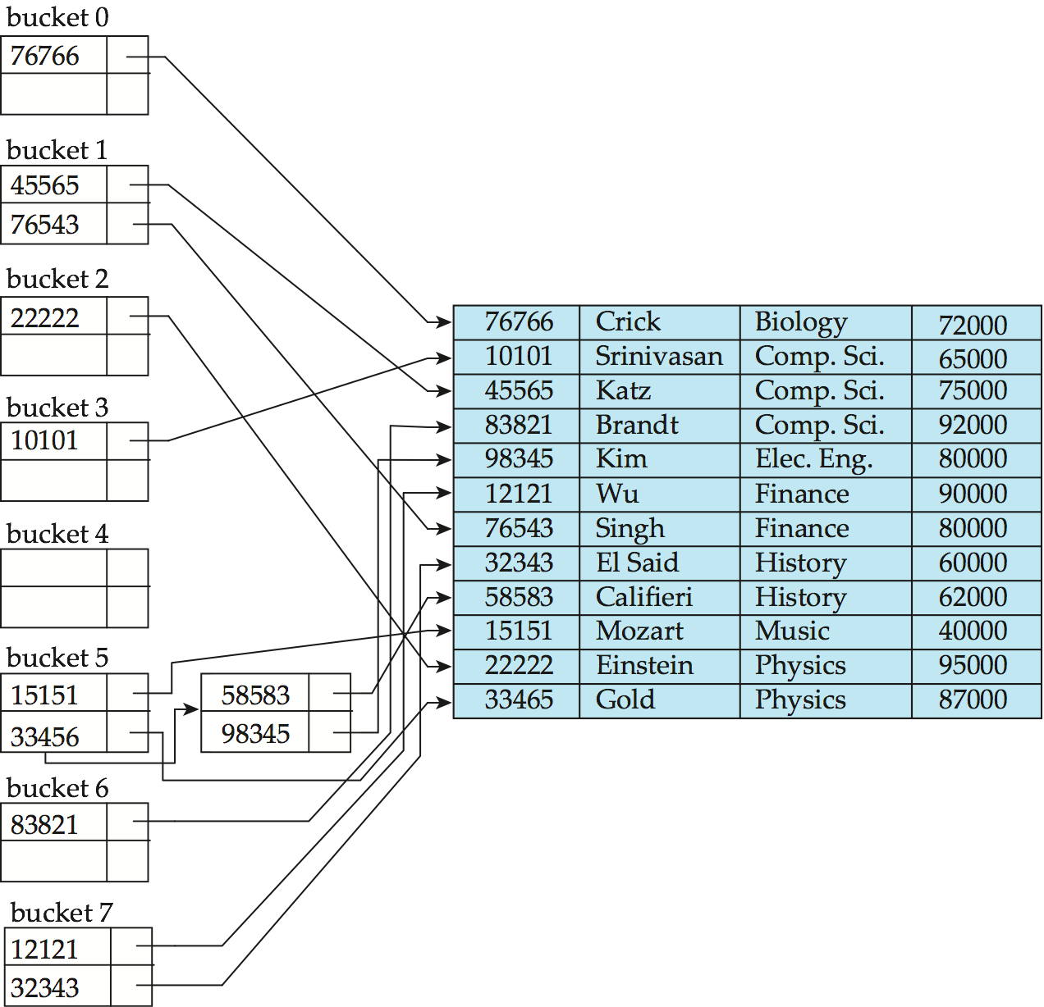
Example of Hash Index
hash index on instructor, on attribute ID

Slide 38
Deficiencies of Static Hashing
In static hashing, function h maps search-key values to a fixed set of B of bucket addresses. Databases grow or shrink with time.
If initial number of buckets is too small, and file grows, performance will degrade due to too much overflows.
If space is allocated for anticipated growth, a significant amount of space will be wasted initially (and buckets will be under full).
If database shrinks, again space will be wasted.
One solution: periodic re-organization of the file with a new hash function
Expensive, disrupts normal operations
Better solution: allow the number of buckets to be modified dynamically.

Slide 39
Dynamic Hashing
Good for database that grows and shrinks in size
Allows the hash function to be modified dynamically
Extendable hashing – one form of dynamic hashing
Notes:
Hash function generates values over a large range — typically b-bit integers, with b = 32.
At any time use only a prefix of the hash function to index into a table of bucket addresses.
Let the length of the prefix be i bits, 0 ≤ i ≤ 32.
Bucket address table size = 2^{i.} Initially i = 0
Value of i grows and shrinks as the size of the database grows and shrinks.
Multiple entries in the bucket address table may point to a bucket (why?)
Thus, actual number of buckets is < 2^{i}
The number of buckets also changes dynamically due to coalescing and splitting of buckets.

Slide 40
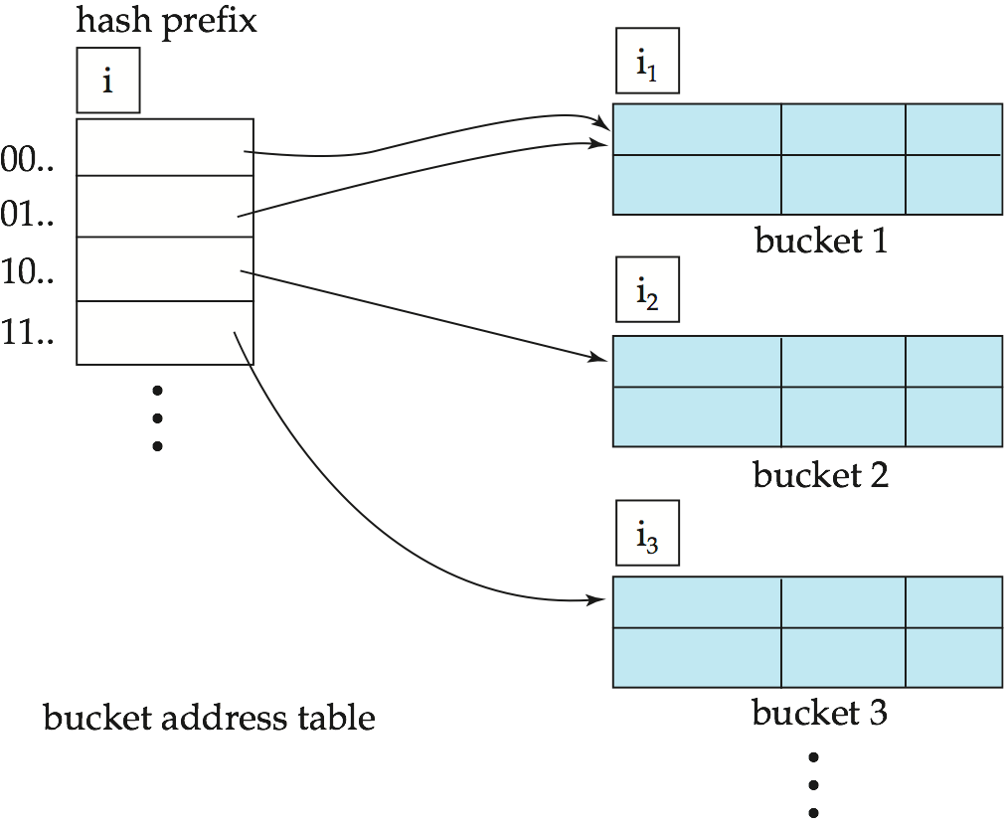
General Extendable Hash Structure
In this structure, i₂ = i₃ = i, whereas i₁ = i – 1 (see next slide for details)

Slide 41
END

